Slide 1
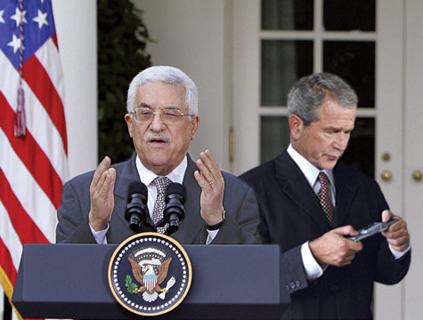
Whoop-Txt! -An IBM Project-
Group Members:
Anthony Balmeo, Jessica Kain,
Zorayr Khalapyan, Wade Norris,
Zachary Policzer, Parth Shah
Client:
Gergana Markova
IBM technical mentors :
Chris Montalvo, Dean Ocamura,
Michael Stein, Neil Sahota,
and Steve Hayachi

Slide 2

What is Whoop-Txt?
A geo-aware mobile web application intended to fuse multiple mobile platforms with Facebook, Google Maps, and other social sites to create an engaging and entertaining text-sharing environment.
Software Goals:
Support creation of texting groups.
Enable users to anonymously broadcast media to others in near vicinity.

Slide 3


Ok…so what is required?
System Features will include:
Group creation and management
Whoop Sharing
Whoop-Txt conversation list
Dependent on API’s
Facebook, Google Maps, Twitter…
User interface shall be easy to navigate and organized into several pages
Authentication page, message stream page, menu page, new message page, and a groups page

Slide 4
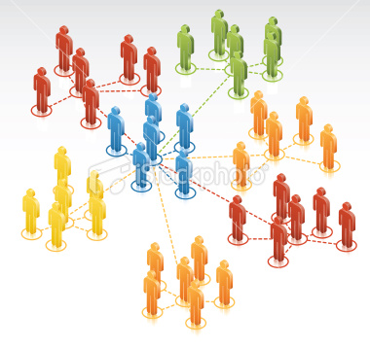
Group Creation and Management
Top priority
Allows users to specify who they will send and receive information from
Functionality:
Create new groups for sharing information
Invite friends to become member of group
Accept/decline invitations
Leave from subscribed group

Slide 5

Whoop Sharing
High priority
Idea of Whoop-Txt is to share content in an easy fashion!
Functionality:
Create a post and share it with explicitly selected “tags” that will modify who will be able to see or be notified of this post.
The user shall be able to select “Public” as a tag to share the post with all members of Whoop-Txt.
The user shall be able to select “Nearby” as a tag to restrict the share only to those within a certain physical distance calculated using users’ geo-locations.
This tag will override other tags such that if a users selects “Public” and “Nearby” it will share it with any Whoop-Txt members within the specified distance.
If the user selects multiple groups they are members of and “Nearby” it will be shared with all of the members of the other groups that are also nearby.

Slide 6


Whoop-Txt Conversation Lists
Highest Priority
The users shall be able to view posts that have been shared with them by other Whoop-Txt users.
Functionality:
View a list of available posts
Select an individual post and view the post’s contents, group members, and the responses that have been shared by recipients of the post.
Share a reply to a post that will be visible by all of the recipients of the original post.
Re-share a post they have received with the same tagging options and interface given to a new share.

Slide 7


User Interface
Authentication page
User’s log in with Facebook account
Message Stream page
List of user’s most recent message posts from other Whoop-Txt users along with their Facebook profile pictures. Included in the top screen of this page is a Menu button.
Menu page
Lists different navigation links:
Home - Takes you to the Message Stream Page,
New Message - Directs you to the Write Message Page.
Groups - Directs you to the Groups Page.
New Message page
Allows you to send posts to other Whoop-Txt users. The user will have the choice of explicitly selecting “tags” that will modify who will be able to see or be notified of this post or they can text people a certain distance away from them.
Groups page
Lists all the groups the user is a part of, whether it is one they have created or have been added to. Users will be able to create custom groups and view members within the groups.

Slide 8
Interface Design

Slide 9
Architectural Design
The front end client utilizing JavaScript will issue AJAX requests to the server which after committing appropriate queries will return query results in JSON format wrapped in an HTTP response.
Using technologies such as AJAX/JSON it is possible to separate responsibilities for the server side developer and the front end developer.
In order to authenticate and authorize users, the server will contact Facebook and utilizing OAuth 2.0 protocol will gain a privileged access token to be used for future requests.
Main components will include a HTML front end, a JavaScript utility component for generation of Mobile Web Framework Code based on data received from the back end, a JavaScript utility component for communication with the back end PHP code, a PHP back end component for interfacing with the database, and a database component for the storage of user data and messages.

Slide 10
Design Overview

Slide 11


Component Design
Html component
Front end of the application and does most of the page creation and styling.
Utilizes the UCLA Mobile Web Framework for generation of mobile friendly pages for all devices.
This framework will be filled in with actual data such as groups, invitations, and messages on certain pages by JavaScript MWF Component.
All parts that do not change based on data in the database will be generated here, while all dynamic data will be filled in later as a responsibility of the lower level component.
JavaScript MWF component
Responsible for generating MWF code to display dynamic data such as a user's messages, groups, or invitations.
Bridge between the JavaScript Communication Component that will get data from the back end and the HTML component that will be a static display written in HTML code.
Receives data in a JSON format and converts that data appropriately to HTML DOM elements that will be placed on the users screen. JavaScript communication component
JavaScript Communication Component
Bridge between JavaScript front end code and PHP back end code.
Responsible for doing AJAX requests to the PHP code to retrieve data from the database.
Requests sent using a standard AJAX format and responses sent in JSON. This JSON response will then be send up a level to the JavaScript MWF Component for generation HTML code.

Slide 12

Component Design (continued)
PHP component
First level of server side code creating a bridge between the database and the client side code.
Written in PHP utilizing SQL to communicate with the database.
Will respond to AJAX requests by converting responses from SQL queries into JSON formatted results.
Will provide an interface in the form of different URLs that take specified parameters and give appropriate JSON responses.
Database component
Responsible for storing all of the data for the application.
Access may be given to authenticated users via SQL queries.

Slide 13


Data Design
A user is uniquely identified by his/her ID.
From users table we can go further to retrieve stored log in information and group information and what messages are associated to a specific user.
‘messages_users’ table associates a text body, a time, and a location to a message.
Queries will consist of inserts to the users table upon a registration or invitation to the application, and inserts of new messages.
For location based messaging, the app will query based on the users current longitude and latitude coordinates and a span of time (say within the last 5 minutes)

Slide 14
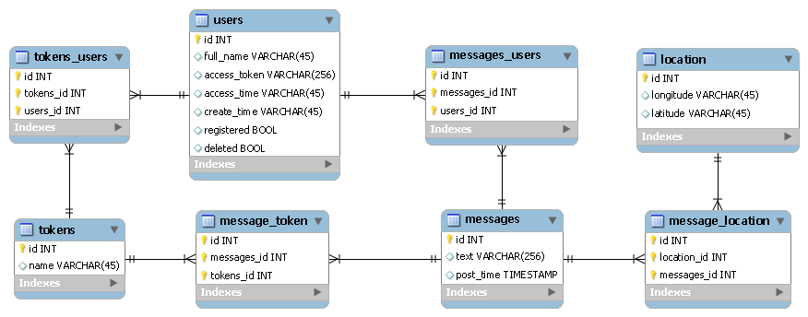
Data Design Overview

Slide 15

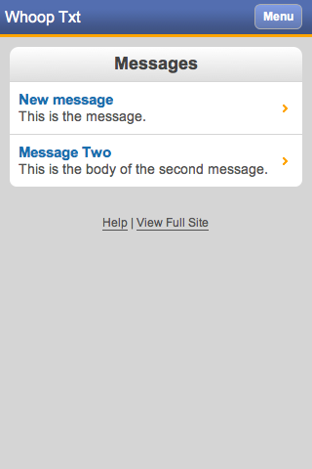
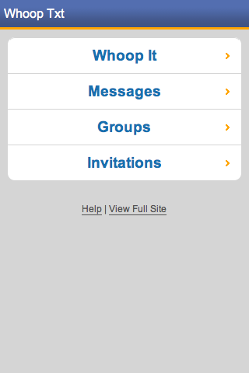
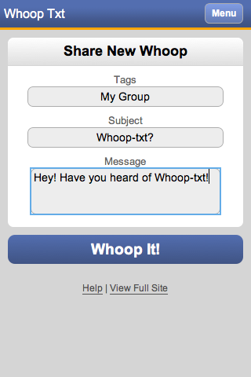
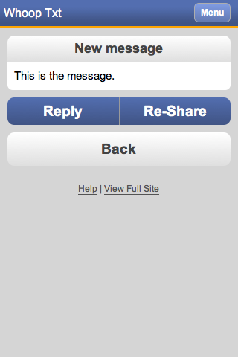
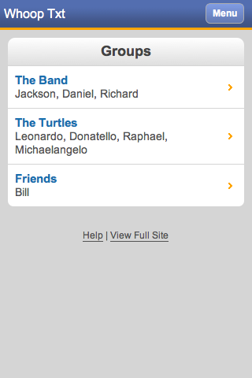
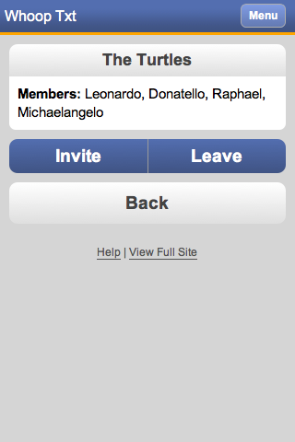
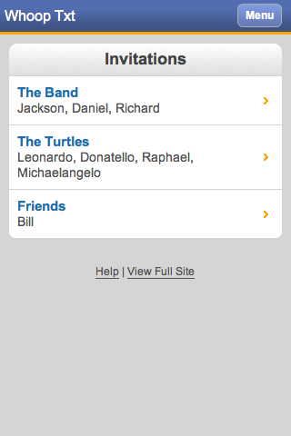
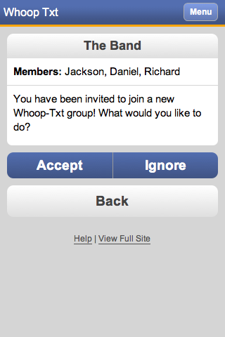
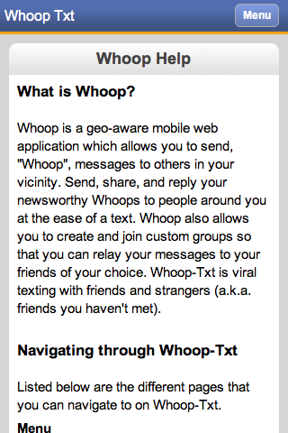
Prototype
http://whoop-txt.com/
Both desktop and smartphone demonstration

Slide 16


Challenges
Deciding Project Title/Domain Name
Many domain names already taken
Legality Issues
Dividing project tasks
Team is split up for different implementations
Front end vs. back end
Task Delegation
Scheduling team meetings and conference call meetings
Back end: Schema
Choosing Facebook login type
Button vs. Facebook login screen shot
Facebook developer website difficult to navigate through
Incorrect Facebook password at log-in provides incorrect navigation to messages page
Home-page Facebook Login Button customization

Slide 17

Future Tasks
Implement mass-text sending capability
Implement group creation
Incorporate geo-location API
Convert web application to native application
Refine user interface
Testing/Refactoring

Slide 18

THE END
Thank you for listening!
Any questions?

